Slide 1
Applying Mindfulness to Traditional CBT Tools: How to Enhance What Works in Terms Your Clients Understand
Jon Hershfield, MFT
October 24, 2017

Slide 2
Why pay attention to mindfulness for OCD?
Two core problems of OCD:
failure to notice when getting carried away by thoughts/slipping into rituals
Difficulty returning from thoughts without precondition (i.e. without ritualizing)

Slide 3
Mindfulness
The ability to observe experiences as they are in the present moment without judgment
Necessarily involves increasing awareness, noticing when distracted from the present moment, and returning without judgment

Slide 4
Incorporating Mindfulness with the Core Elements of CBT
Psycho-education on the disorder and its treatment conceptualization
Cognitive restructuring – challenging distorted thought processes that lead to compulsive behavior
Behavioral therapy – exposure with response prevention (ERP)

Slide 5
Psychoeducation and Mindfulness
After explaining O-C cycle, negative reinforcement, habituation, ERP, etc., clients still want to know:
Why do I think this way?
Do other people have these thoughts?
Why do these thoughts seem so important?

Slide 6
Ask, When’s your birthday?
To get the answer, you look inside the brain, find the birthday file and report on it
That which you look through to see what’s in the brain is called the mind
You are the observer of what the mind reveals

Slide 7
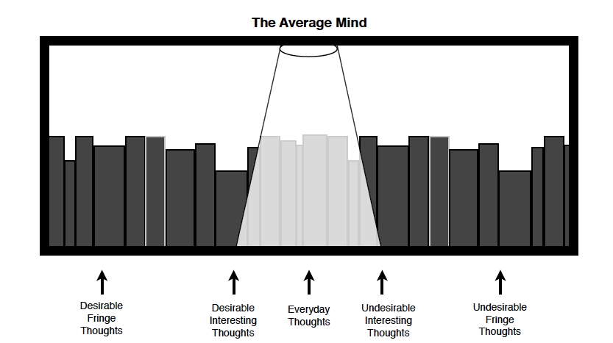
The spotlight
Hershfield, J and Corboy, T. (2013) The Mindfulness Workbook For OCD: A Guide to Overcoming Obsessions and Compulsions Using Mindfulness and Cognitive Behavioral Therapy. New Harbinger Publications: Oakland, CA

Slide 8
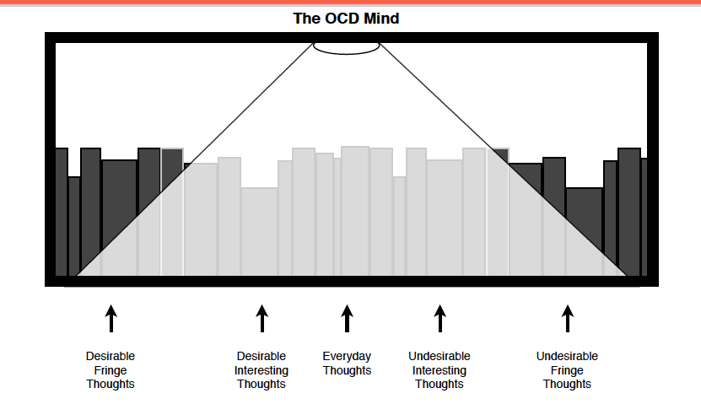
The spotlight
Hershfield, J and Corboy, T. (2013) The Mindfulness Workbook For OCD: A Guide to Overcoming Obsessions and Compulsions Using Mindfulness and Cognitive Behavioral Therapy. New Harbinger Publications: Oakland, CA

Slide 9
Don’t shrink the spotlight, understand it
Problems arise when we get confused by the “brightness” or “loudness” of our thoughts and conflate them with importance
Re-positioning ourselves as observers allows us to enjoy the enjoyable thoughts and make space for the uncomfortable ones

Slide 10
Thoughts as mental events
Thoughts are thoughts, not threats (not “JUST a thought” – which implies value)
Value is unknown, not intrinsic
To be acknowledged, observed
Be curious about them or disinterested, not avoidant

Slide 11
Feelings as raw data
Feelings are feelings, not facts
Not evidence, significance is unknown
Mental appraisals of physical sensations
To be experienced in the moment, not sought after or checked for
Pain (a present experience) vs. suffering (same experience plus a narrative and resistance)

Slide 12
Physical sensations as nerves firing
Not mandates to act
Also not evidence, personal significance uncertain (i.e. groinal response as fear or arousal)
Cause unknown
To be experienced, not explained unless medically impairing

Slide 13
The Aquarium
To be mindless is to view your thoughts as sharks and yourself as being in the sharktank in imminent danger, reacting to evade being eaten
To be mindful is to view yourself as standing in an aquarium, watching sharks swim by, allowing both the disturbing feelings that come with being near them and the curiosity about them free from the threat of annihilation

Slide 14
Mindfulness and cognitive restructuring
Changing what-if to what-IS (attention to the process of thinking about the experience, not the content of the thoughts)
Not neutralizing or reassuring
Aim to discourage compulsions based on skepticism of the OCD logic, not to get certainty

Slide 15
Common distortions and reframes
Black-and-white
I am dirty and must wash.
I am uncomfortable because my finger touched something and I don’t know what was on it. Washing may not be the best use of my time right now.

Slide 16
Common distortions and reframes
Catastrophizing
I’m will get AIDS and die unless I get tested asap.
This is a typical thought for me when I see a cut. I can’t predict the future. In my experience the tests provide little relief.

Slide 17
Common distortions and reframes
Emotional reasoning
I feel gay, I must be in denial. I need to figure this out right now.
Things I obsess about make my heart rate go up and when I check my groin I notice sensations. I could just finish the movie and accept I got my buttons pushed.

Slide 18
Mindfulness and ERP
Exposure with Response Prevention (ERP)
Gradually making contact with feared stimuli while resisting urges to compulsively neutralize or reassure
Mindfulness = ERP to being in the presence of unwanted thoughts/feelings without engaging in rituals

Slide 19
ERP Goals
Bring the unwanted thought or feeling into the present moment
Stay with the discomfort associated with uncertainty about the thought/feeling
Resist the urge to avoid or change this discomfort
Willingness to cope with all possible outcomes because there’s no other choice
Habituation (reduced anxiety over time) and/or inhibitory learning (reduced reactivity to anxiety as a threat signal)

Slide 20
Mindfulness Goals
Allow unwanted thoughts and feelings to be present when they occur
Acknowledge the associated discomfort
Observe (not react to) urges to avoid or change the discomfort/reduced reactivity

Slide 21
Basic meditation (the “practice” of mindfulness)
Checking in: “Here I am in this space.” The weight of the body. Touch: Feet on the floor, legs on the seat, hands on the lap, air on the face. Tastes, smells. Sounds: Opening up the ears to sounds close and far away.
Resting attention on the anchor (e.g. the breath coming in and going out)
Noticing when attention is not on the anchor
Resting attention on the anchor (beginning again)

Slide 22
Basic meditation (the “practice” of mindfulness)
To develop the practice of noticing and returning, mental noting (labelling thinking, feeling, itching, boredom, heartbeat, irritation, etc) can be included
Amount of time not particularly important. 5-20 minutes plenty. To be viewed as an exercise in OCD treatment, not an enlightenment path.
Guided apps can be useful (e.g. Headspace, 10% Happier)

Slide 23
Why Meditation Can Help
Adds an additional tool to the tool box (but beware of using meditation as escape from pain)
Reinforces the concept of homework completion and discipline in overcoming OCD.
Built-in ERP to fears of inadequacy, unwanted thoughts/feelings, and fear of wasting time.

Slide 24
Why Meditation Can Help
Allows for the question, “What would I do in this moment if this trigger occurred while I was meditating?”
Makes the assessment of “thoughts as thoughts” more habitual/instinctual, less prone to ritualizing, taking the bait, or self-reassuring.

Slide 25
Meditation Challenges
Asking an OCD sufferer to clear their mind is counterproductive – do not clear, notice busy
10,000 hands pulling you away from your anchor – meditation may seem impossible
Performance evaluation, more effort = less success
Trying to relax

Slide 26
When Mindfulness Attacks
Thoughts are “just” thoughts is a judgment
“It’s not me, it’s my OCD” vs. “It is me and so be it.” – the problem with relabeling/reattributing
Perfectionism and the solving ritual
Checking the present
Meditation as a compulsion

Slide 27
Thank you!
jon@ocdbaltimore.com
ocdbaltimore.com
410-927-5462

