Slide 1
Cognitive Behavioral Assessment
Emily Hemendinger, LCSW, MPH
Rachel A. Davis, MD
Stephanie Lehto, PsyD

Slide 2
Cognitive Behavioral Assessment
1. Understand the obsession(s) and core fear(s)
2. How does the person attempt to neutralize the obsessions(s)?
3. How else does the person avoid their fear?
4. What cognitive distortions does the individual have/use?

Slide 3
Three Components of Obsessions
Triggers
External: “contaminated” objects, tasks involving responsibility, asymmetry, e.g. bump in the road, article about ethics
Internal: disturbing thoughts or images about sex, violence, or immorality
Intrusive thoughts/feelings
“I might have just hit someone.” “I might have committed insurance fraud.” “I might have missed a finding on an MRI.” “I am a bad person.” “I feel disgusting.” “I feel uncomfortable.”
Core fears (feared consequences)
“I will end up isolated and alone in prison.” “I will get fired.” “Someone will die, and I will have to feel guilty forever.” “I cannot tolerate feeling this way.”
Jonathan Grayson’s Obsessive Concerns Checklist

Slide 4
Feared Consequence: If I don’t ritualize, this will happen
Proximal, specifiable catastrophic events
Interminable, intolerable distress: not just right/disgust
Interminable, intolerable distress: uncertainty
(A. Pollard IOCDF 2017)

Slide 5
Downward Arrow to Identify Core Fear
Trigger: bowel movement
Intrusive thought: “I might smell like poop.”
Why is that bad? People will smell me →they’ll talk about me behind my back → I won’t know they’re talking about me → they’ll think I’m gross → they’ll start to avoid me → I will be isolated and lonely

Slide 6
Different Core Fears for Same Obsession
Contamination
Get sick and die
Get g.i. illness and vomit → feel out of control → scary, cannot tolerate
Psychological contamination → become like the “bad” person → do evil things → go to hell
“just right” contamination → will not be able to tolerate feeling uncomfortable → will not be able to function in life
Get sick → not be able to function in school → not graduate → be unable to get a job → end up homeless and miserable
Get sick → have to keep functioning in school → be extremely miserable → it will be unbearable

Slide 7
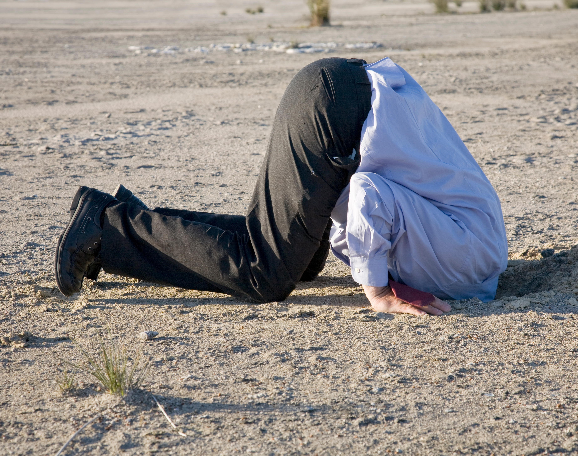
Avoidance
Primary: staying away from the trigger
Secondary: rituals/compulsions ➔ seeking safety when stimulus cannot be avoided

Slide 8
Primary Avoidance
Sleeping
Distracting
Ignoring
Not leaving house
Isolating
Substance use
Procrastinating
Skipping class or work

Slide 9
Compulsions (secondary avoidance)
Negative reinforcement (removal of negative experience/helping escape distress)
Involves no pleasure
Ego-dystonic
Types: Behavioral and Mental

Slide 10
Rituals
Preventing and restoring
Analyzing and figuring out
Controlling and stopping feelings
Controlling and stopping thoughts
Wishing
Rituals are done to avoid anxiety just as much or more than to avoid the feared consequence.
Notes:
Now let’s talk about rituals or compulsions (and avoidance)
It’s important to note that rituals are done to…
Functions:
Prevent something from happening or “fix’ something (undoing) [checking, washing, cleaning]
Trying to understand completely [Googling, asking questions, clarifying, researching, tangent while studying]
Trying not to feel a certain way [e.g. guilt – replay a scenario, ask for reassurance]
Trying not to think particular thoughts [cuss words patient example]
Wishing is an interesting one. People can spend a lot of time thinking about the way things could have been or could be, e.g. living in fantasy to avoid pain [social situations]

Slide 11
Behavioral Compulsions
Washing
Checking
Reassurance-seeking
Repeating
Straightening
Organizing
Confessing
Researching
Maintaining routines
Jonathan Grayson’s Compulsive Activities Checklist

Slide 12
Mental Compulsions
Counting
Mental Reviewing
Reasoning
Scenario bending
Figuring it out
Thought or image replacement
Thought neutralization or suppression
Mental rehearsal
Memory hoarding
Praying
Mental self-punishment

Slide 13
Cognitive Distortions
Intolerance of Uncertainty/Anxiety
Overestimation of threat
All or nothing/black and white thinking
Emotional Reasoning
Thought-action fusion
Magical thinking
Inflated sense of responsibility
Thought control
Catastrophizing
Discounting the positive
Selective abstraction/mental filter
Mind reading
Personalizing
Perfectionism
*Common Cognitive Distortions Used by People with OCD
Notes:
Link to

