Slide 1
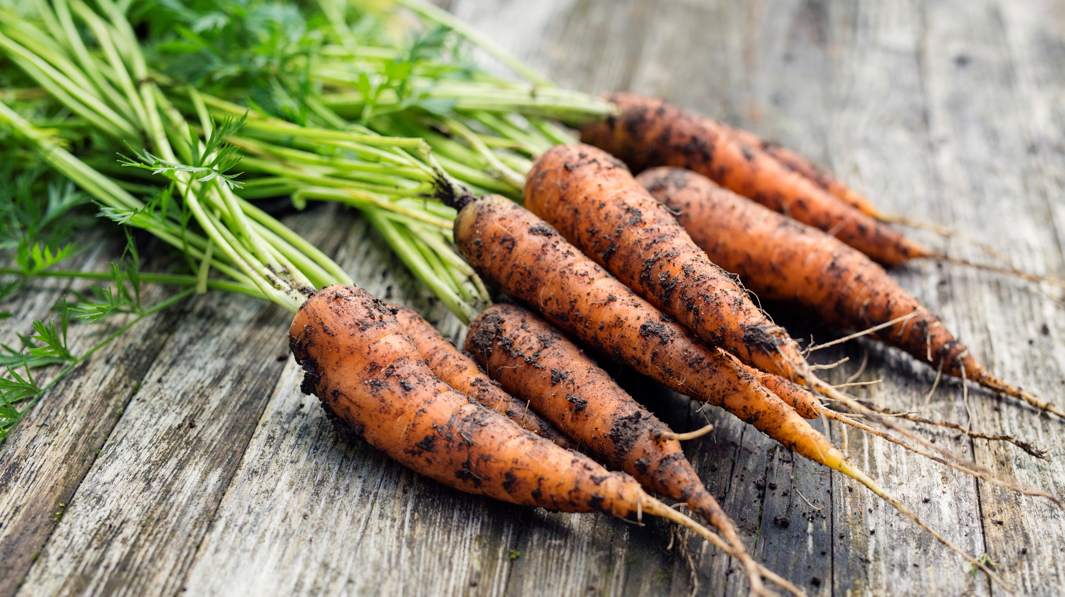
Exposures
(names)

Slide 3
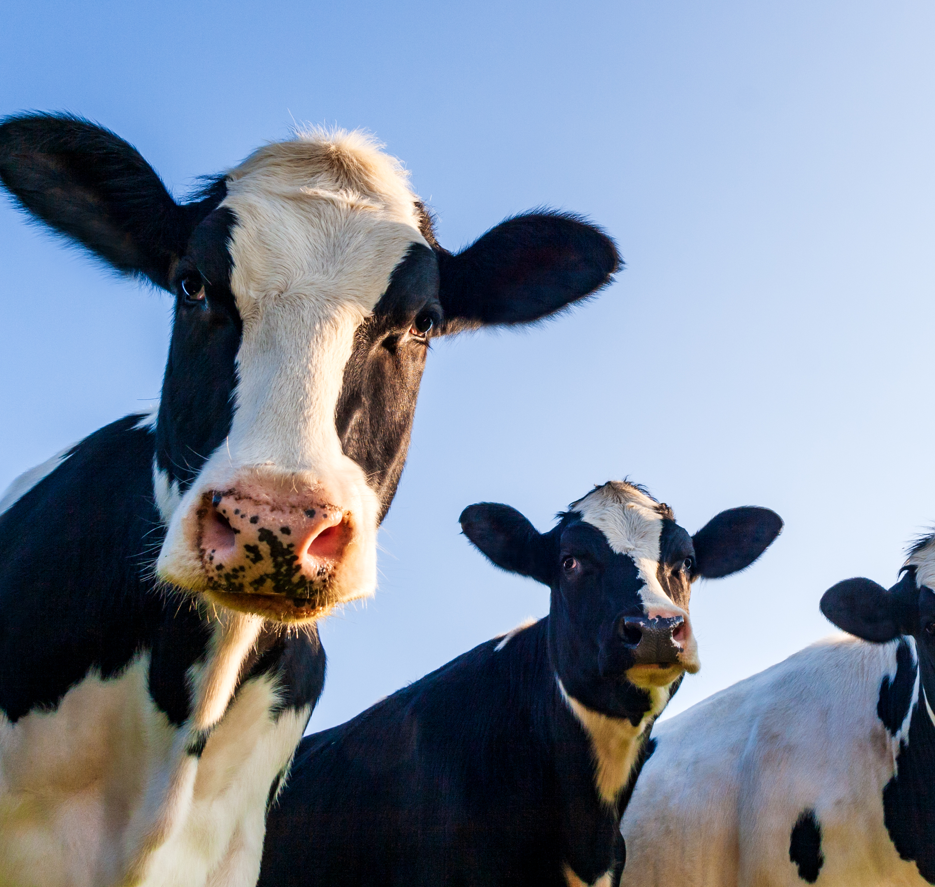
Types of Exposures: In-vivo/Situational
Intentionally facing fears
Agreed upon that are intended to be as similar to the fear as possible
Include situations that are avoided or there are safety behaviors with
May involve completing sessions out of the office
Notes:
References
Abramowitz, J. S., Deacon, B. J., & Whiteside, S. P. H. (2011). Exposure therapy for anxiety: Principles and practice. Guilford Press.

Slide 4
Types of Exposures: Imaginal
Scripting exercises
Prompts for types of OCD are in “The Mindfulness Workbook for OCD”
Exposures to intrusive thoughts/images
Method to explore mental cues/triggers
The aim is to have exposure to mental events and tolerate these events/that these events are not dangerous
Notes:
Scripting handout
References
Abramowitz, J. S., Deacon, B. J., & Whiteside, S. P. H. (2011). Exposure therapy for anxiety: Principles and practice. Guilford Press.

Slide 5
Imaginal Continued
Primary Imaginal Exposure: exposure to intrusive thoughts
Secondary Imaginal Exposure: used with in-vivo exposures to face outcomes that are not able to occur (example: drive around the block and imagine someone being hit by the car)
Preliminary Imaginal Exposure: Used to prep for a in-vivo exposure
Notes:
References
Abramowitz, J. S., Deacon, B. J., & Whiteside, S. P. H. (2011). Exposure therapy for anxiety: Principles and practice. Guilford Press.

Slide 6
Types of Exposures: Interoceptive
Used when there is a fear of body sensations to decrease misinterpretation of meaning
Examples:
Emetophobia: Spinning on a chair, laying with books on the stomach, quickly drinking soda
Somatic/hyper-awareness OCD: Intentionally focus on a body sensation that is feared, such as swallowing, blinking, breathing
Fear of signs of a panic attack: Physical exercise to increase heart rate, breathing through a straw to simulate hyperventilating
Notes:
References
Abramowitz, J. S., Deacon, B. J., & Whiteside, S. P. H. (2011). Exposure therapy for anxiety: Principles and practice. Guilford Press.

