Slide 1
Psychoeducation
Stephanie Lehto, PsyD

Slide 2
CBT Model
Thoughts
Feelings
Behaviors

Slide 3
CBT Model
Thoughts
“I might want to stab my mom”
Feelings
Anxiety, disgust
Behaviors
Avoidance of knives
Avoidance of mom
Confessing
Reassurance seeking

Slide 4
I feel better
I’M ANXIOUS
(Mental compulsion) I remember unplugging it
But what if I didn’t?
I might not have turned off my straightener
But what if I didn’t?
I feel better
I’M ANXIOUS
(Compulsion) driving home to check

Slide 5
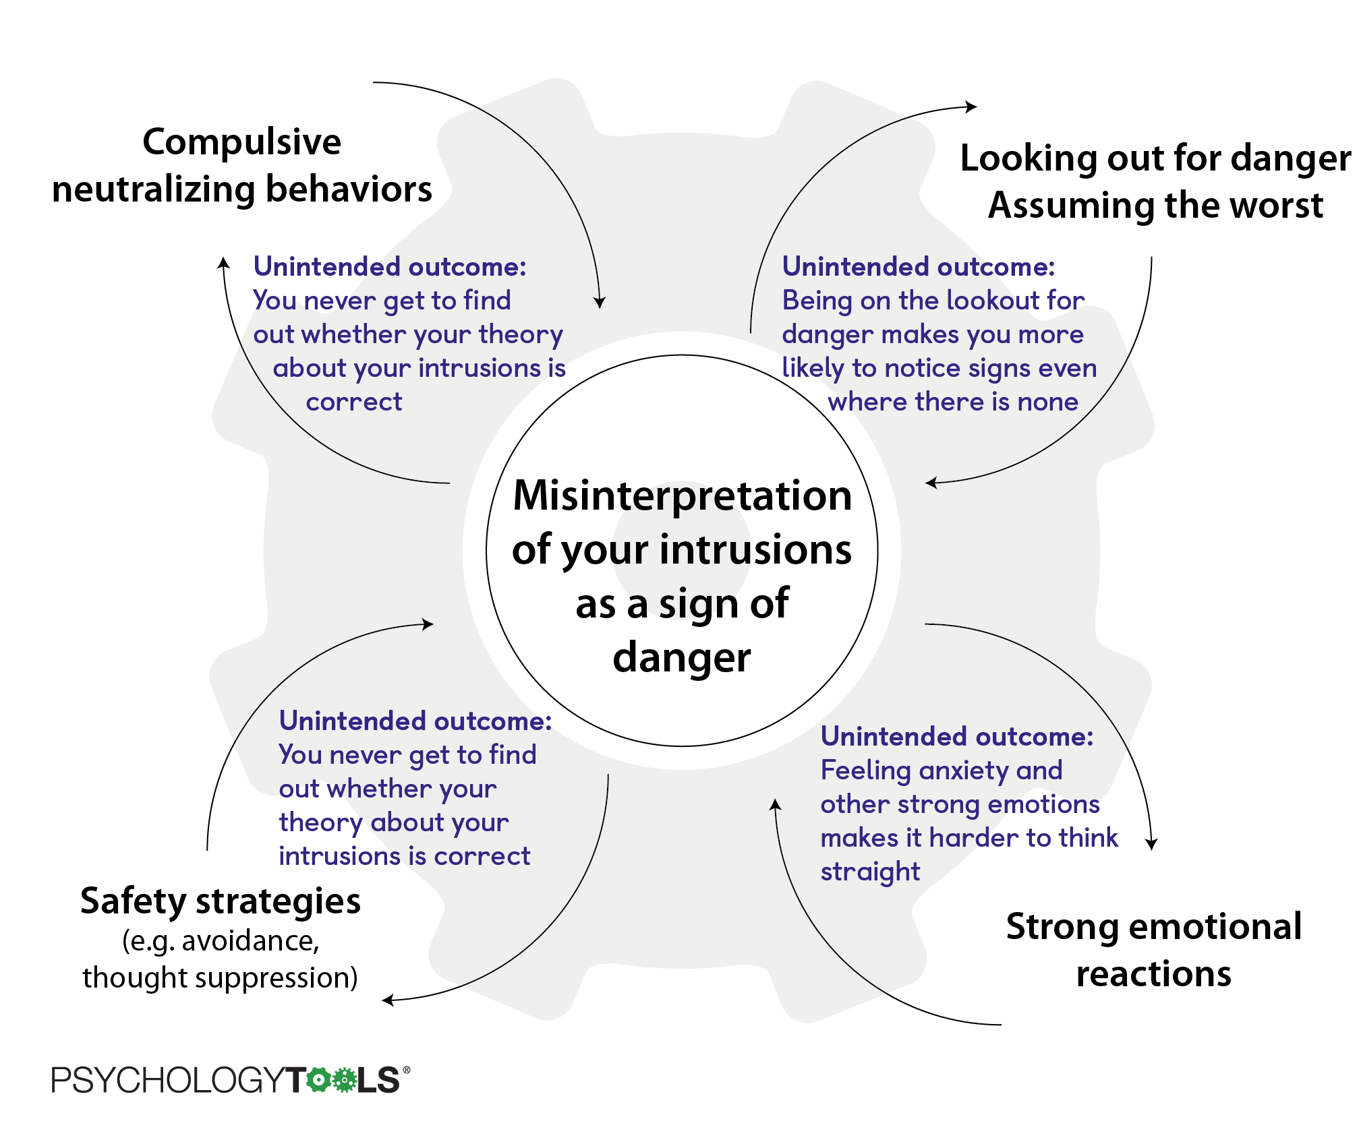
Notes:
https://www.psychologytools.com/self-help/obsessive-compulsive-disorder-ocd/

Slide 6
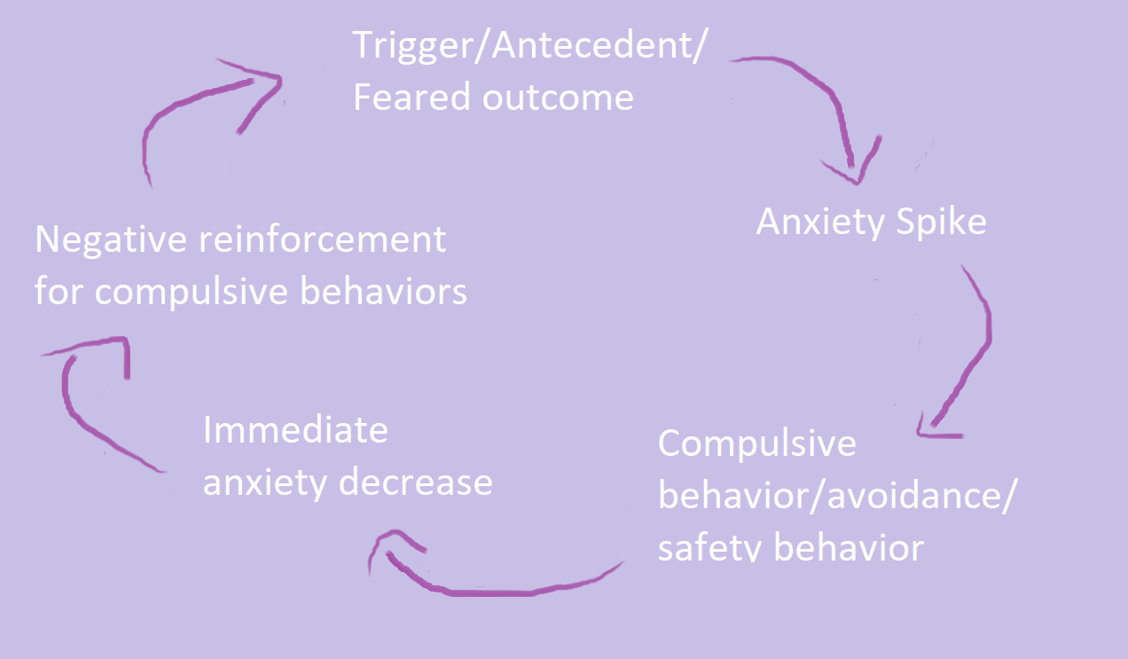

Slide 7
Exposure and Response Prevention
Identify feared outcome/core fear
Create a hierarchy for exposures to feared outcome
Intentionally face the fear
Do not do safety behaviors/create a response prevention plan
Habituation
Inhibitory learning

Slide 8
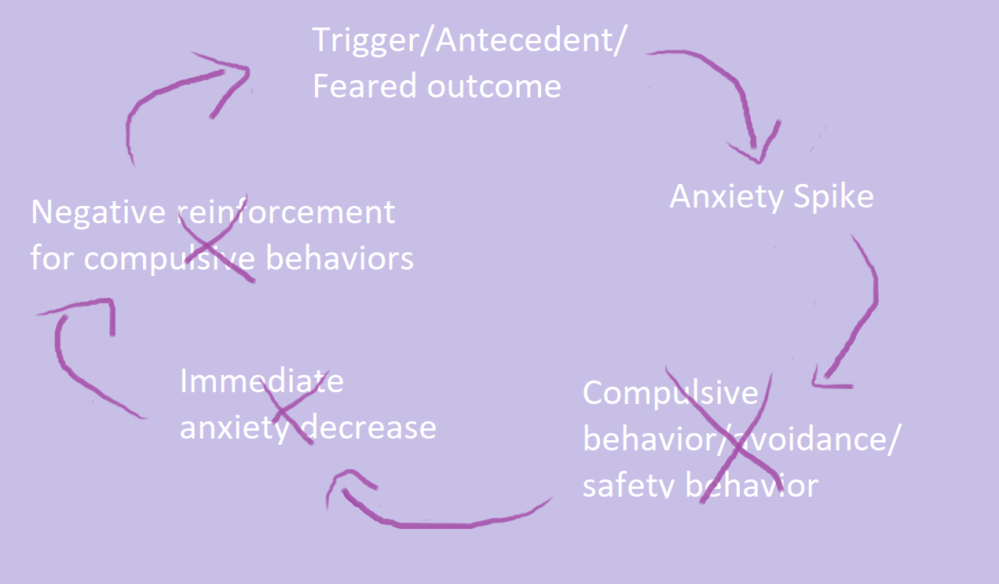

Slide 9
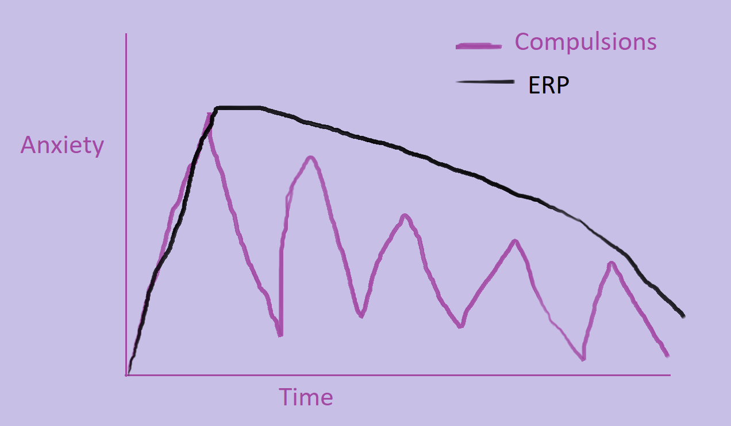

Slide 10
Habituation
Also known as anxiety reduction
Goal to reduce anxiety through exposures, usually with a gradual approach to exposures
Potentially shames anxiety and reinforces idea that anxiety/distress is intolerable or “bad”
Suggests that exposure therapy is only successful if anxiety is “gone”
Notes:
References
Abramowitz, J. S., Deacon, B. J., & Whiteside, S. P. H. (2011). Exposure therapy for anxiety: Principles and practice. Guilford Press.

Slide 11
Inhibitory Learning
Explains differences between exposure SUDs and SUDs after exposure
Fear-based thoughts are not gone, but remain and new learning occurs (Example: Fear that all dogs will bite is changed to most dogs are safe)
The fear may decrease, but the thought/meaning may return
Goals of exposures are to 1: Develop new thoughts, 2: Increase use of new thoughts across different settings
Notes:
References
Abramowitz, J. S., Deacon, B. J., & Whiteside, S. P. H. (2011). Exposure therapy for anxiety: Principles and practice. Guilford Press.

Slide 12
Inhibitory Learning Continued
Therefore, there is fear tolerance not fear extinction or “no anxiety”
May also introduce “desirable difficulties”
Randomly pick exposures vs moving through a fear hierarchy
Not using coping skills during exposures
May increase learning that anxiety is tolerable vs something to avoid
Notes:
References
Abramowitz, J. S., Deacon, B. J., & Whiteside, S. P. H. (2011). Exposure therapy for anxiety: Principles and practice. Guilford Press.

Slide 13
Identify Primary and Secondary Avoidance
Reminder -
Primary: staying away from the trigger
Secondary: rituals/compulsions ➔ seeking safety when stimulus cannot be avoided
Notes:
Rachel

Slide 14
Primary Avoidance
Reminder – examples of primary avoidance:
Sleeping
Distracting
Ignoring
Not leaving house
Isolating
Substance use
Procrastinating
Skipping class or work
Notes:
Rachel

Slide 15
Secondary Avoidance - Compulsions
*Y-BOCS Symptom Checklist
*Compulsive Activities Checklist (Jonathan Grayson)

Slide 16
Distress Tolerance - Skills
CBT:
Building awareness to cognitive distortions
Mindfulness skills
Grounding

Slide 17
Distress Tolerance - Skills
ACT:
Acceptance of thoughts/feelings
Cognitive defusion for thoughts
Mindfulness
Use of Values (can also be used to help find motivations for exposures)
Committed action
Self-as-context

Slide 18
Distress Tolerance - Skills
STOP
Self-soothing through the senses
DBT:
TIPP
Imagery

Slide 19
Response prevention guidelines
Notes:
Rachel

Slide 20
Response prevention guidelines
More than telling them to “just stop it”
New rules for behavior
2 kinds of ritual behavior
Abnormal/unnecessary (e.g., tapping, counting)
Excess of normal behavior (e.g., washing)
Need to specify what to do and when to do it, not just what not to do
Form: *Response Prevention Plan
May need to specify “normal” behavior (e.g., washing)
*Anxiety Disorders Center, Saint Louis Behavioral Medicine Institute
Notes:
Rachel
During exposure, focus on the fear, e.g. with contamination → resist urge to wash, focus on feeling of contamination
Outside of planned exposure → re-focus on the present moment, follow normal wash guidelines
Reassurance is a compulsion →”figuring out with a guest”, people will argue in search of 100% certainty
“Normal behavior”, e.g. normal urination

Slide 21
Response Prevention Plan:
Notes:
Rachel

Slide 22
Response Prevention Plan:
Notes:
Rachel

Slide 23
Response Prevention Plan:
Notes:
Rachel

Slide 24
Breakout – Response Prevention Plans
Group 1 (Rachel): normal urinating in a public restroom for a guy
Group 2 (Emily): normal driving
Group 3 (Stephanie): wiping after a bowel movement

