Slide 1
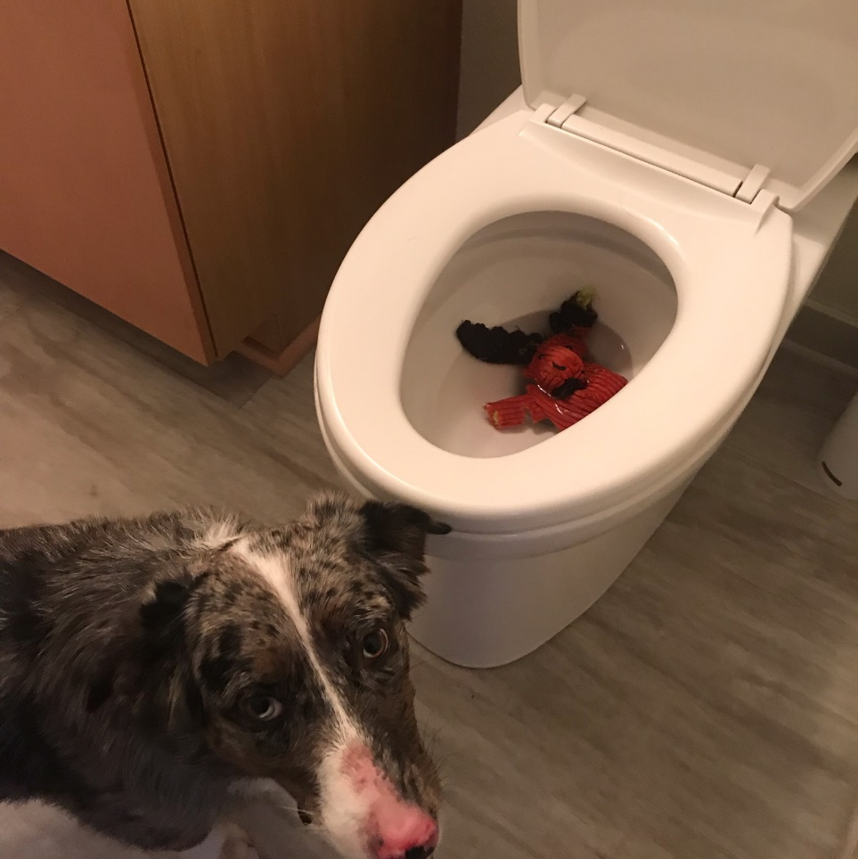
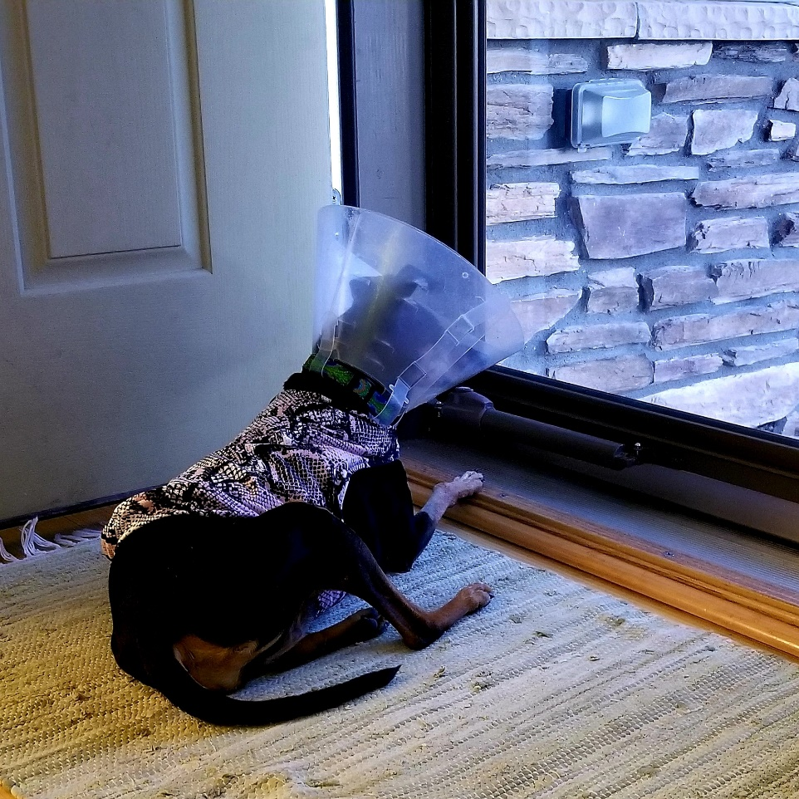
Exposure and Response Prevention
Mental Health Partners
July 2021

Slide 2
University of Colorado Anschutz OCD Program

Slide 3
OCD Overview

Slide 4
Learning Objectives
Identify the DSM-5 diagnostic criteria for OCD
Ask appropriate evaluation questions to uncover and identify a diagnosis of obsessive-compulsive disorder (OCD).
Identify common comorbidities.
Describe the role of uncertainty in OCD.
Explain the biopsychosocial model of OCD

Slide 5
A Warm-up Exercise
Notes:
Grab the piece of paper in front of you.
Write “I want”
Now write the name of someone you care about
Now write “to die a horrible and painful death.”
…By show of hands, who all had difficulty?
Magical thinking
Thought action fusion
Hyper-responsibility

Slide 6
Conflicts of Interest
Rachel Davis provides paid ad hoc consulting for Medtronic.

Slide 8
OCD - DSM-5
A. Presence of obsessions, compulsions, or both
B. Greater than 1 hr per day or cause distress/impairment
C. Not attributable to substance or medical condition
D. Not explained by another mental disorder
Specify:
Good or fair insight
Poor insight
Absent insight
Tic-related
American Psychiatric Association. (2013). Diagnostic and statistical manual of mental disorders: DSM-5. Washington, D.C: American Psychiatric Association.

Slide 9
Obsessions
1. Recurrent and persistent thoughts, urges, or images
Intrusive and unwanted
Cause anxiety or distress
2. Individual attempts to ignore, suppress, or neutralize
American Psychiatric Association. (2013). Diagnostic and statistical manual of mental disorders: DSM-5. Washington, D.C: American Psychiatric Association.
Notes:
Not an enjoyable thought

Slide 10
Compulsions
1. Repetitive behavior or mental act
Feels driven to perform in response to an obsession
2. Aimed at preventing or reducing anxiety or distress
Excessive or unrealistically connected
American Psychiatric Association. (2013). Diagnostic and statistical manual of mental disorders: DSM-5. Washington, D.C: American Psychiatric Association.

Slide 11
Triggers, Obsessions, and Feared Consequences
Trigger: environmental or mental
Obsession: what the sufferer fears
Feared Consequence: if I don’t ritualize, this will happen
Notes:
Now I’ll talk about some of the features of OCD. People have obsessions and compulsions. Let’s look at the obsession part first. It’s important to differentiate between a person’s obsession and their feared consequences. What and Why
Important to incorporate the feared consequence into exposure therapy.
Examples: hit and run → end up in jail, go to hell, live with perpetual guilt; fear of vomiting → choke and die, can’t stand the feeling/being out of control, public humiliation; contamination → acute illness vs. cancer, down the road illness

Slide 12
Don’t confuse OCD with…
Preoccupation/stalking
Rumination
Addiction/impulsion/appetitive habit
Tic
OCPD
Worry (though GAD and OCD are very similar processes)
Notes:
“obsessed” (pleasurable component)
Rumination more with depression
Pleasurable component (at least to begin with), e.g. skin picking or cutting
Done in response to sensation, not an obsession
Ego-syntonic
More “realistic” concerns

Slide 13
OCD
Lifetime prevalence of 2.3%
Average of 11 years before diagnosis
98% have fair to good insight
(not delusional)
Early Onset (11.81 yrs) vs. Late
Onset (26.64 yrs)
Notes:
These are some statistics about OCD.
There are a number of reasons there is such a gap between onset and diagnosis – good insight (people know to hide their symptoms), shame and embarrassment, misattribution to other disorders such as psychosis or generalized anxiety disorder
Bimodal age of onset - Higher association with tics in childhood-onset OCD

Slide 14
Biopsychosocial Model
Genetic component
Psychological vulnerabilities from early life experiences
Trauma
Dysfunctional beliefs
Modeled through family, media, society
Stereotypes
Stigma
Cultural norms and standards
Maladaptive form of coping
Notes:
Stephanie

Slide 15
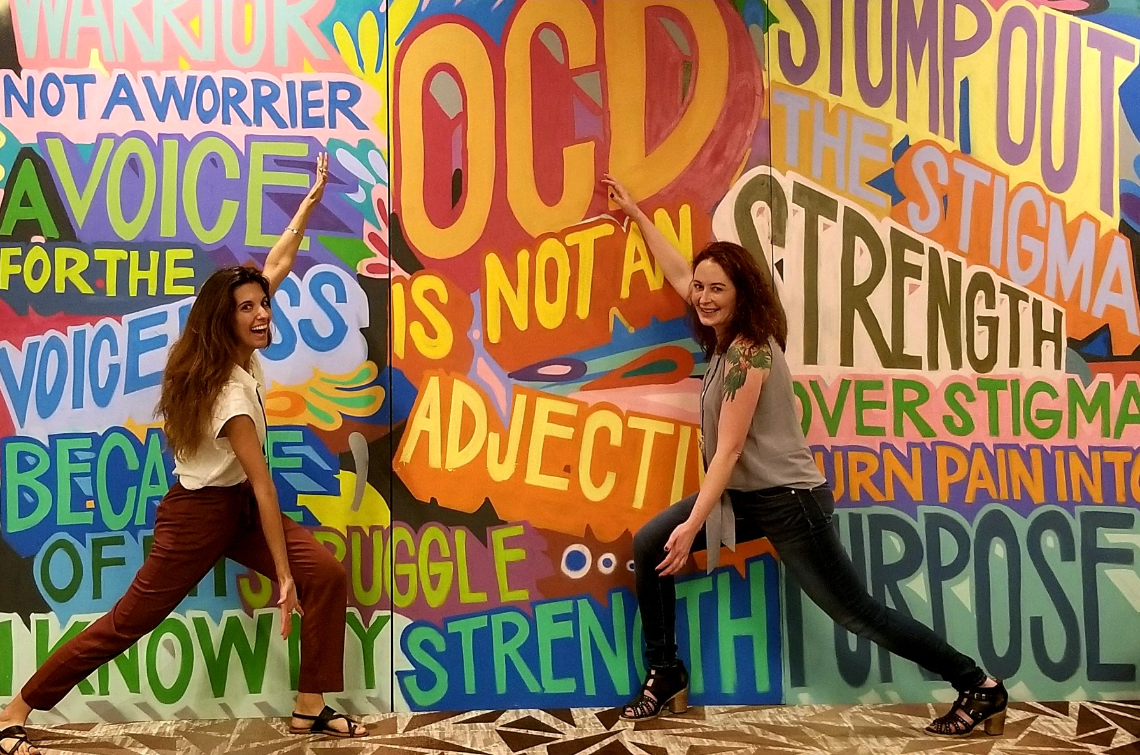
Notes:
Stephanie

Slide 16
Cycle of OCD
Fear Stimulus
Pre-existing Beliefs
Obsession
Environmental Factors
Anxiety
Avoidant Coping
Transient Relief (absence of corrective experience)
Notes:
Stephanie
Use example that isn’t a particular patient’s problem
Behaving like there is a problem reinforces that there actually IS a problem (THINK OF EXAMPLE)
Brain is biased towards interpreting danger but then we orient/correct → once your brain believes it’s dangerous, it’s locked in without corrective experience. Safety learning does not generalize like danger learning → if you generalize too quickly you could do something dumb (if it’s a rational fear) → exposures need to be in multiple settings. Safety learning does not persist without repeated corrective experiences

Slide 17
References
Ruscio AM, Stein DJ, Chiu WT, Kessler RC. The epidemiology of obsessive-compulsive disorder in the National Comorbidity Survey Replication. Molecular Psychiatry. 2010; 15: 53-63.
Murray CJ, Lopez AD. The Global Burden of Disease. Boston, MA: Harvard University Press; 1996.
Pinto A, Mancebo MC, Eisen JL, et al. The Brown Longitudinal Obsessive Compulsive Study: Clinical Features and Symptoms of the Sample at Intake. J Clin Psychiatry. 2006; 67(5):703-711.

Slide 18
Comorbidities in OCD
Substance use disorder 27%
Personality disorder 45%
Major depression 35-67%
Bipolar disorder 16%
Eating disorder 13% (11-42%)
Panic disorder 18%
Tic disorder 14%
ADHD 10-30%
Notes:
Emily
Brown Longitudinal Study – In terms of lifetime Axis I comorbidity, only 9% had OCD alone.
SUD: 70% reported OCD preceded SUD by at least 1 year
PD: Avoidant and OCPD
Tic disorder: about 40% of those with tic disorder also have OC symptoms (Fernandez-Alvarez E. Comorbid disorders associated with tics. Rev Neurol. 2002;34(S1):S122-129.)
Eating Disorder: 41% of those with an eating disorder have OCD (

Slide 19
Comorbidity of OCD and Anorexia Nervosa
OCD 17 X more common in individuals with AN than would be expected by chance
16X higher in women
37 X higher in men
Initial diagnosis of OCD increases risk of later AN diagnosis and vice versa
OCD dx = 4X higher risk of later diagnosis of AN
AN dx = 10x higher risk of later diagnosis of OCD
Notes:
Emily
Population based study using Swedish National Patient Register
Opposite findings of OCD coming first vs. AN coming first
Primarily hospitalized patients so may be over-representative of OCD with severe comorbidities such as AN requiring hospitalization

Slide 20
Eating Disorders and OCD
Shared common childhood traits:
Perfectionism
Following the rules
Conscientiousness
Concern about mistakes
Up to 69% of patients with AN and 33% of patients with BN have a coexisting dx of OCD (CASA, 2003)
Both EDs and OCD are manifestations of anxiety
The National Center on Addiction and Substance Abuse (CASA). (2003). Food for Thought: Substance Abuse and Eating Disorders. New York: CASA at Columbia University.
Notes:
Emily
Common childhood traits such as perfectionism, following the rules, conscientiousness, concern about mistakes, common with those who developed eating disorders (Tagay et al, 2014)
Up to 69% of patients with AN and 33% of patients with BN have a coexisting dx of OCD (CASA, 2003)
Both EDs and OCD are manifestations of anxiety

Slide 21
OCD vs. Eating Disorders
Counting bites/chewing according to a fixed or magical number that is “Correct” or “just right” vs. counts mouthfuls or pieces of food as a means of limiting portions
Washing hands for fear of germs/contamination vs. washes hands to remove tiny amounts of oil that might cause weight gain if ingested
Individual repeatedly asks waiter at restaurant about different dishes on the menu, doubtful that they have enough knowledge yet to make the perfect meal decision vs. individual constantly asks waiter about contents of dishes so as to stay away from having any butter oil or fat
Notes:
Emily
Clinician must examine the specific bxs and the motivations behind them (e.g. patients with EDs primarily driven by concerns of physical appearance and then alter their eating patterns in order to lose weight; OCD patients may be restricting their eating for reasons other than body image concerns
EDs (primarily AN), are typically ego-syntonic vs. OCD is typically ego-dystonic (what is the relationship the individual has with their thoughts and actions; are obsessions and compulsions in conflict or aligned with their identity)
In EDs, the individual often sees themselves and the illness as one; that the illness is their identity. Recovery is very difficult due to fear of not knowing who they will be without the ED
In OCD, there is a strong distinction the individual has between themselves and the disorder; typically interested in getting rid of the OCD thoughts and bxs, because they are experiencing the disorder as highly unpleasant and separate from themselves
Are symptoms being motivated by both disorders simultaneously (e.g. patient washing groceries due to fear of contamination as well as fear that the products may contain high fat ingredients)
Examples:
Individual counts the number of mouthfuls chewed or pieces of food in a meal according to a fixed or magical number that is “Correct” or “just right” vs. individual counts mouthfuls or pieces of food as a means of limiting portions, thus losing more weight
Individual repeatedly washes hands due to fear of germs or other possible sources of contamination vs. individual excessively washes hands to remove tiny amounts of oil that might cause weight gain if ingested
Individual repeatedly asks waiter at restaurant about different dishes on the menu, doubtful that they have enough knowledge yet to make the perfect meal decision vs. individual constantly asks waiter about contents of dishes so as to stay away from having any butter oil or fat

Slide 22
Eating disorders and OCD
Shared features of fear and low tolerance to uncertainty; perfectionism
Rituals associated with EDs share many characteristics with bxs seen in OCD
Both people with EDs and people with OCD experience intrusive thoughts and compulsive actions
Important Difference:
Eating disorders tend to be ego syntonic
OCD tends to be ego dystonic
Notes:
Emily
Shared features of fear and low tolerance to uncertainty of OCD can also lead those with EDs to strive for perfection in things such as weight, shape, or control through rigid rules around food, exercise, or purging
ED can emerge as coping mechanism for OCD and other anxiety disorders; OCD often comes before ED
Combined tx of cognitive therapy with ERP
Patient recovers from one, the other disorder symptoms increase due to difficulty managing anxiety and feeling out of control; rigidity takes on another form in their life
For those with only an eating disorder, these obsessions and compulsions are typically limited to thoughts and actions related to food and/or weight (e.g. excessive exercise; repetitive calorie counting; body checking; frequent weighing)
Important Difference: people with eating disorder do not view intrusive thoughts and bxs as problematic necessarily, where people who have OCD typically find these thoughts and bxs distress; with an ED, the thoughts and bxs help to maintain the condition and aligns with their d/o

Slide 23
References - Comorbidities
Pinto A, Mancebo MC, Eisen JL, et al. The Brown Longitudinal Obsessive Compulsive Study: Clinical Features and Symptoms of the Sample at Intake. J Clin Psychiatry. 2006; 67(5): 703-711.
Mancebo MC, Grant JE, Pinto A, Eisen JL, Rasmussen SA. Substance Use Disorders in an Obsessive Compulsive Disorder Clinical Sample. J Anxiety Disord. 2009; 23(4): 429-435.
Samuels J, Nestadt G, Bienvenu OJ, et al. Personality disorders and normal personality dimensions in obsessive-compulsive disorder. Br J Psychiatry. 2000; 177: 457-462.
Perugi G, Akiskal HS, Pfanner C, et al. The clinical impact of bipolar and unipolar affective comorbidity on obsessive-compulsive disorder. Journal of Affective Disorders. 1997; 46: 15-23.
Overbeek T, Schruers K, Vermetten E, Griez E. Comorbidity of Obsessive-Compulsive Disorder and Depression: Prevalence, Symptom Severity, and Treatment Effect. J Clin Psychiatry. 2002; 63(12): 1106-1112.

Slide 24
References - Comorbidities
-Rubenstein CS, Pigott TA, L’Heureux F, Hill JL, Murphy DL. A preliminary investigation of the lifetime prevalence of anorexia and bulimia nervosa in patients with obsessive compulsive disorder. J Clin Psychiatry. 1992; 53(9): 309-314.
⁻Gellar DA, Biederman J, Griffin S, Jones J, Lefkowitz TR. Comorbidity of juvenile obsessive-compulsive disorder with disruptive behavior disorders. J Am Acad Child Adolesc Psychiatry. 1996; 35(12): 1637-1646.
-Kaye WH, Bulik CM, Thornton L, Barbarich N, Masters K, and the Price Foundation Collaborative Group. Comorbidity of anxiety disorders with anorexia and bulimia nervosa. The American Journal of Psychiatry. 2004;161(12):2215-2221.
-Cederlof M, Ruck C, Culik CM. Etiologic overlap between obsessive-compulsive disorder and anorexia nervosa: a longitudinal cohort, multigenerational family and twin study. World Psychiatry. 2015;14(3):333-338.

Slide 25
References - Comorbidities
-Altman, S. E., & Shankman, S. A. (2009). What is the association between obsessive-compulsive disorder and eating disorders? Clinical Psychology Review, 29, 638-646.
-The National Center on Addiction and Substance Abuse (CASA). (2003). Food for Thought: Substance Abuse and Eating Disorders. New York: CASA at Columbia University.

Slide 26
Diagnostic Questions
Do you have any OCD symptoms such as:
Disturbing thoughts you really don’t want to have about death, sex, violence, or any other topic?
The need to do rituals or habits to make sure something bad doesn’t happen, for example checking, counting, repeating, confessing, or asking for reassurance?
Do you avoid certain things to prevent feared consequences?
Notes:
People with OCD don’t often volunteer their symptoms so it helps to have a couple screening questions when you first meet someone. When I ask the questions, I specifically label the symptoms I’m asking about as OCD.

Slide 27
Screening and Symptom Measures
Obsessive Compulsive Inventory (OCI-R)
Dimensional Obsessive-Compulsive Scale (DOCS)
Obsessive Concerns Checklist
Compulsive Activities Checklist
Y-BOCS
Y-BOCS-II
Better for tracking progress than for diagnosing OCD

Slide 28
Genetics
11.7% of those with OCD have a first degree relative with OCD
Monozygotic concordance 68%
Odds Ratio for 1st degree relative: 4.56-5.03
OCGAS and IOCDF-GC GWAS
No genome-wide significant findings
Notes:
OCD has a strong genetic component with 68% monozygotic concordance.
Baseline odds = 42.5:1
GWAS → case control, take people with and without disease or trait → dna sample→look at millions of snps

Slide 29
Candidate Genes
Serotonin
5HTTLPR (SLC6A4), HTR2A
Dopamine
DAT1, DRD3 (non-significant trends)
Glutamate
SLC1A1 (non-significant trend)
COMT and MAOA in males
Notes:
Candidate genes →focus on areas of interest (due to known function or relevance)→ case control→ is the allele of a gene seen more frequently in subjects with disease vs. without
DA and Glutamate maybe did not reach statistical significance due to smaller number of studies.

Slide 30
References - Genetics
Nestadt G, Samuels J, Riddle M, et al. A family study of obsessive-compulsive disorder. Arch Gen Psychiatry. 2000; 57: 358-363.
Nestadt G, Grados M, Samuels JF. Genetics of OCD. Psychiatr Clin North Am. 2010;33(1): 141- 158.
Mataix-Cols D, Boman M, Monzani B, et al. Population-Based, Multigenerational Family Clustering Study of Obsessive-Compulsive Disorder. JAMA Psychiatry. 2013; 70(7): 709-717.
Mattheisen M, Samuels JF, Wang Y, et al. Genome-wide association study in obsessive-compulsive disorder: results from the OCGAS. Molecular Psychiatry. 2015; 20: 337-344.
Stewart SE, Yu D, Scharf JM, et al. Genome-wide association study of obsessive-compulsive disorder. Molecular Psychiatry. 2013; 18: 788-798.
Taylor S. Molecular genetics of obsessive-compulsive disorder: a comprehenisive meta-analysis of genetic association studies. Mol Psychiatry. 2013;18(7):799-805.

Slide 31
Neuropsychology of OCD – 2013 meta-analysis
Abramovitch A, Abramowitz JS, Mittelman A. The neuropsychology of adult obsessive-compulsive disorder: A meta-analysis. Clinical Psychology Review. 2013. 33:1163-1171.
Notes:
0.2 = small effect size (1/5 of a SD)
0.5 = medium effect size (1/2 of a SD)
0.8 = large effect size (8/10 of a SD)
1/3 to 3/4 standard deviation worse than controls (? Differences of less than 2 SD meaningful?)
[No available research has yet examined functional correlates of neuropsychological test performance in OCD
Difficult to draw conclusions about OCD-specific NP profile

Slide 32
Neurotransmitters
Serotonin
Serotonin hypothesis comes from observation of drug effects (clomipramine)
SSRI →increased binding to striatal D2 receptors
5HT both activating and inhibitory on striatal dopaminergic neurons
Dopamine
Depletion of dopamine in caudate leads to impaired performance on reversal learning
Depletion of dopamine in OFC leads to impaired extinction
Glutamate
GABA
Notes:
Functional association between serotonin and dopamine
Possibly involves a change in balance between OFC serotonin levels and dorsal striatal dopamine levels (DBS = increased striatal dopamine)

Slide 34
References - Neurotransmitters
Navailles S, De Deurwaerdere P. Presynaptic control of serotonin on striatal dopamine function. Psychopharmacology (Berl). 2011;213(2-3):213-242.
Pauls DL, Abramovitch A, Rauch SL, Geller DA. Obsessive-compulsive disorder: an integrative genetic and neurobiological perspective. Nature Reviews Neuroscients. 2014;15:410-424.

Slide 35
38
Basal Ganglia
Cortico-striatal-thalamic-cortico (CSTC) pathways
Image downloaded from: http://commons.wikimedia.org/wiki/File:Basal_ganglia_circuits.svg
Notes:
Basal Ganglia composed of: dorsal striatum (caudate and putamen), ventral striatum (nucleus accumbens and olfactory tubercle), globus pallidus, ventral pallidum, substantia nigra, and subthalamic nucleus

Slide 36
Treatment
Combination of serotonergic medication plus ERP yields best results
20-40% of patients do not respond to conventional treatment
Only 20-37% achieve complete recovery.
Notes:
Foa - response = CGI improvement = 2
Completer response rate = 79% CMI+ERP
Treated response rate = 70% CMI+ERP
Simpson – remission = YBOCS </= 12
Completer remission rate = 68% CMI+ERP
Treated remission rate = 58% CMI+ERP
OR response = >35% decrease in YBOCS
Completer response rate = 79% CMI+ERP
Treated response rate = 65% CMI+ERP
Skoog – complete recovery = “absence of clinical relevant and subclinical symptoms for 5 years or more; prospective naturalistic 40-year f/u (not correlated to type of treatment received)
Eddy – recovery =
Simpson - remission= YBOCS </=7
Completer remission rate = 37% CMI+ERP
Treated remission rate = 35% CMI+ERP

Slide 37
References – treatment response
Ponniah K, Magiati I, Hollon SD. An update on the efficacy of psychological therapies in the treatment of obsessive-compulsive disorder in adults. J Obsessive Compuls Relat Disord.2013 2(2): 207-218.
Foa EB, Liebowitz MR, Kozak MJ, et al. Randomized, placebo-controlled trial of exposure and ritual prevention, clomipramine, and their combination in the treatment of obsessive-compulsive disorder. Am J Psychiatry.2005;162(1):151-61.
Simpson HB, Huppert JD, Petkova E, Foa EB, Liebowitz MR. Response versus remission in obsessive-compulsive disorder. J Clin Psychiatry. 2006;67(2):269-276
Skoog G, Skoog I. A 40-year follow-up of patients with obsessive-compulsive disorder. Arch Gen Psychiatry.1999;56(2):121-127.

Slide 38
Medication
Serotonergic medications 1st line
12 weeks is a sufficient trial!
Antipsychotics
Benzodiazepines
Other: stimulants, glutamate modulating agents
Notes:
Serotonergic agent and/or CBT/ERP →
(APA Practice Guideline for the treatment of patients with obsessive-compulsive disorder 2007)

Slide 39
Serotonergic Medications
SSRI | FDA Max Dose (mg)/OCD Max Dose/Occasionally Prescribed
Citalopram | 40/80**/120**
Clomipramine* | 250/250/keep plasma levels <500ng/mL
Escitalopram | 20/40/60
Fluoxetine* | 80/80/120
Fluvoxamine* | 300/300/450
Paroxetine* | 50/60/100
Sertraline* | 200/200/400
* FDA approved for treatment of OCD **FDA 2011 warning for prolonged QTc at doses >40mg
Notes:
Escitalopram and citalopram not FDA-approved for OCD
All SSRIs equally effective even though all not FDA approved
4-6 weeks for response in most patients, 10-12 weeks for response in some

Slide 40
Clomipramine
Side effects
α1-adrenergic antagonism: orthostatic hypotension
Histamine (H₁) blockade: weight gain and sedation
Anticholinergic: tachycardia, urinary retention, dry mouth, blurred vision, constipation
Na channel blockade: seizures and arrhythmias (0.7%)
Screening EKG in those with heart disease or >40 y/o
Goal Serum Levels
12-hour levels
Steady state 2-3 weeks (32/69h half-life)
Clomipramine (CMI): 225-350 ng/mL
CMI+Norclomipramine (desmethylclomipramine): </= 500ng/mL
http://ocd.stanford.edu/treatment/pharma.html
Notes:
Clomipramine discovered in 1964 → made from imipramine

Slide 41
CMI + SSRI
Drug interactions
Fluvoxamine
Paroxetine and fluoxetine
Monitor plasma levels
Notes:
Clomipramine metabolized by 1A2, 2D6, 2C19, 3A4
Fluvoxamine is a potent inhibitor of 1A2
Clomipramine is a 2D6 inhibitor

Slide 42
Other Serotonergic Agents
Mirtazapine 15-30mg
Weight gain
SNRIs
Venlafaxine 225-350mg
Trazodone
250-600mg/day
Notes:
Adding mirtazapine to SSRI may speed response but not change overall response rate
SNRIs not FDA-approved but some evidence

Slide 43
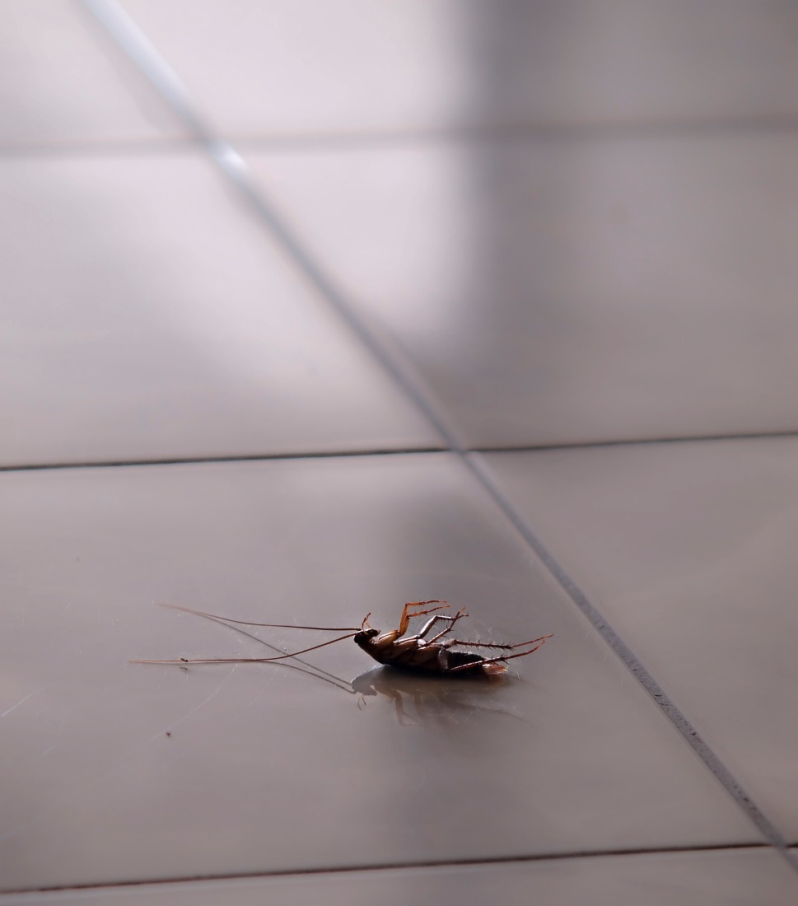
Antipsychotics
Mixed results with antipsychotics
Those with comorbid tics more likely to respond
Haloperidol
2-10mg
Quetiapine
Risperidone
Aripiprazole
Olanzapine
Atypicals may also exacerbate OCD symptoms
Clozapine most likely
Case reports of Risperdal, olanzapine, and quetiapine
Notes:
Quetiapine (may be effective in small subset)
OCD+tics child/adol. (aripiprazole 8.9+/-3.1mg or risperidone 1.7+/- 0.8mg) = 68.1% response rate (out of 69 non-responders to SSRI monotherapy)

Slide 44
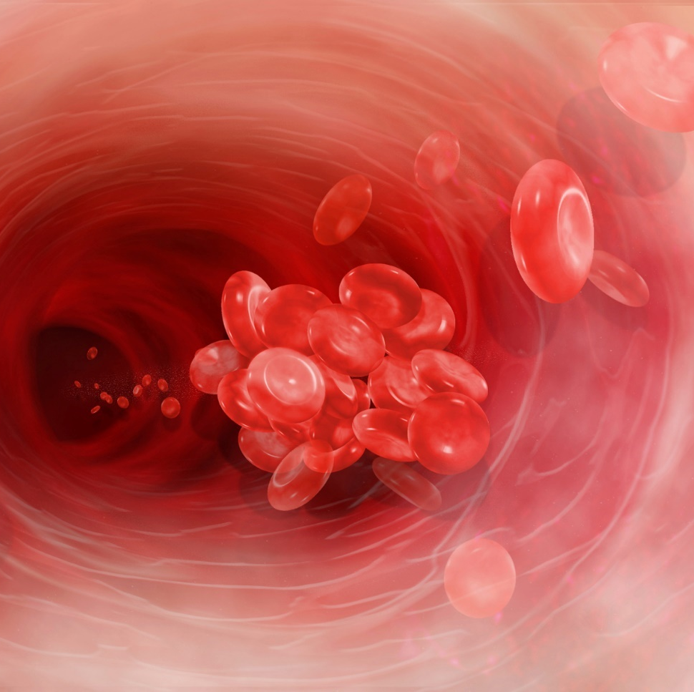
Glutamate Modulators
Topiramate 50-400mg/day
Not well tolerated
Lamotrigine 100mg/day
Memantine 20mg/day
N-acetyl cysteine 1200mg bid
g.i. distress
Notes:
Topamax: dbl blind placebo controlled trial
49 subjects, avg180mg/day → 12 response on Topamax (>/=25% YBOCS) vs. 0 on placebo
Lamotrigine: 16 wk dbl blind randomized placebo controlled study (N=40), titrated to 100mg over 4 wks
50% YBOCS >/=25% response, additional 35% YBOCS responders, 0% response in placebo group
Memantine:
open-label 14 patient who had failed to respond to 12wks of stable SSRI dose received memantine titrated to 20mg/day →43% responders (35%YBOCS)
Open-label 10 patients with OCD received memantine 20mg TDD →7 patients experienced decline in YBOCS of 45% or more
Iranian dbl blind placebo controlled trial (N=42), memantine titrated to 20mg TDD vs. placebo (added to fluovoxamine which was titrated to 200mg/day)→100% response (YBOCS 35%) in memantine group vs. 32% in placebo group
NAC: (N=48) with inadequate response to 12 wks of SSRI received NAC up to 2400mg TDD vs. placebo →52.6% response (YBOCS 35%) vs. 15% response for placebo

Slide 45
Stimulants
Two double-blind crossover trials and several case reports
5-wk double blind randomized study (augmentation):
Dextroamphetamine 30mg/day: 33% response week 1 and week 5
High dose caffeine – 300mg/day: 42% response week 1, 50% response week 5
Notes:
Mean placebo response = 11%
Monotherapy and augmentation

Slide 46
Other Agents (augmentation)
Benzodiazepines
Commonly used but minimal evidence
May impair learning in CBT/ERP
Ketamine
Ondansetron 1-4g/day
Lithium
Case reports
Efficacy clearly established with comorbid bipolar
Buspirone 60mg/day
Case series, inconsistent results
Once weekly morphine 30-45mg
Double-blind cross-over study
Pindolol 2.5mg tid
Small double-blind placebo-controlled trial
Riluzole 50mg bid
Small open-label

Slide 47
References - medication
-American Psychiatric Association. Practice guideline for the treatment of patients with obsessive-compulsive disorder. Arlington, VA: American Psychiatric Association; 2007: available online at http//www.psych.org/psych_pract/treatg/pg/prac_guide.cfm.
-Koran, LM and Simpson HB: Guideline Watch (March 2013): Practice Guideline for the treatment of patients with obsessive-compulsive disorder. Arlington, VA: American Psychiatric Association; 2013. Available online at psychiatryonline.org/guidelines.
-Starcevic V, Berle D, do Rosario MC, et al. Use of benzodiazepines in obsessive-compulsive disorder. Int Clin Psychopharmacol. 2016;1:27-33.

Slide 48
Somatic Therapies
Transcranial Magnetic Stimulation (rTMS)
SMA, mPFC, dmPFC,
High frequency (20Hz) deep (Brainsway coil) with positive results
Deep Brain Stimulation (DBS)
Ablative surgeries
ECT
Not recommended as primary treatment for OCD
For co-occurring depression
Notes:
rTMS – studies mixed with some positive results including

Slide 49
Deep Brain Stimulation for OCD Humanitarian Device Exemption – VC/VS
18 or older with OCD diagnosis for at least 5 years
Marked functional impairment
YBOCS >/= 28 (severe – extreme OCD)
Three 12 wk trials of serotonergic agents including clomipramine
Augmentation with antipsychotic and long-acting benzodiazepine
At least 20 sessions of ERP
No comorbid bipolar, psychotic disorder, active substance use disorder or severe personality disorder
Hamani C, Pilitsis J, Rughani A. Deep brain stimulation for obsessive-compulsive disorder: systematic review and evidence-based guideline sponsored by the American society for stereotactic and functional neurosurgery and the congress of neurological surgeons (CNS) and endorsed by the CNS and American Association of Neurological Surgeons. Neurosurgery. 2014. 75(4): 327-333.
Notes:
Introduced in 1999 for OCD
1999 – DBS first used for OCD
2009 – US FDA granted HUD
Less than 100 people
Surgery based on the hypothesis of hyperactivity and hyper-connectivity within the cortico-striatal-thalmic-cortico tract

Slide 50
References - Images
Images obtained from istockphoto.com. Subscription # 14415225. Downloaded April 2015.

Slide 51
Contact Information
Rachel.Davis@CUAnschutz.edu
Emily.Hemendinger@CUAnschutz.edu
Stephanie.Lehto@CUAnschutz.edu

